Slide 1
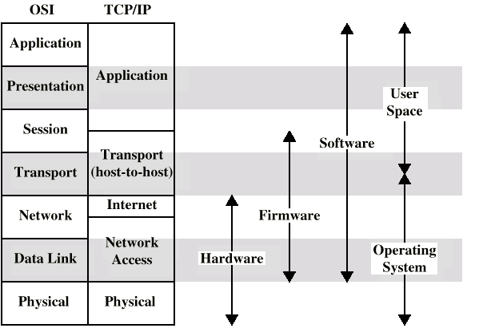
William Stallings Data and Computer Communications
Chapter 7
Data Link Control

Slide 2
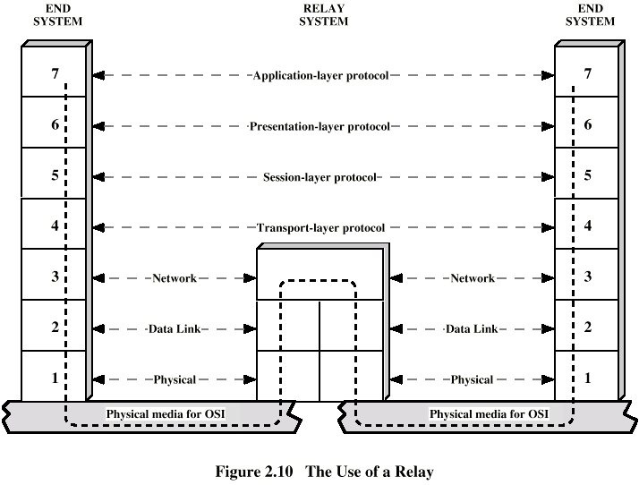
Flow Control
Ensuring the sending entity does not overwhelm the receiving entity
Preventing buffer overflow
Transmission time
Time taken to emit all bits into medium
Propagation time
Time for a bit to traverse the link

Slide 3
Stop and Wait
Source transmits frame
Destination receives frame and replies with acknowledgement
Source waits for ACK before sending next frame
Destination can stop flow by not send ACK
Works well for a few large frames

Slide 4
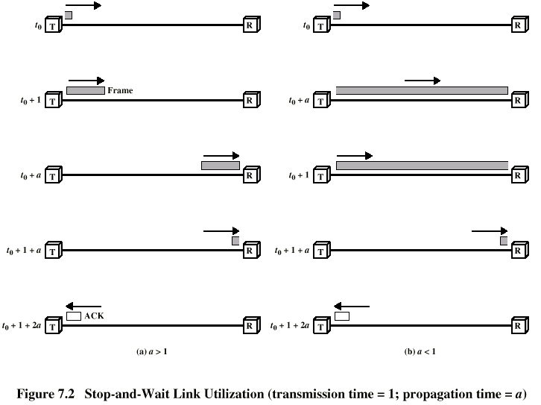
Stop and Wait Link Utilization

Slide 5
Fragmentation
Large block of data may be split into small frames
Limited buffer size
Errors detected sooner (when whole frame received)
On error, retransmission of smaller frames is needed
Prevents one station occupying medium for long periods
Stop and wait becomes inadequate

Slide 6
Sliding Windows Flow Control
Allow multiple frames to be in transit
Receiver has buffer W long
Transmitter can send up to W frames without ACK
Each frame is numbered
ACK includes number of next frame expected
Sequence number bounded by size of field (k)
Frames are numbered modulo 2^{k}

Slide 7
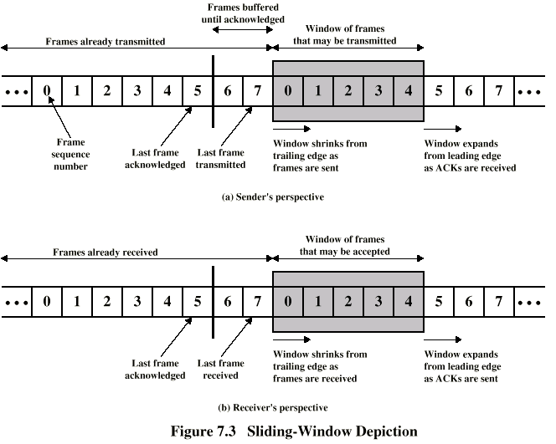
Sliding Window Diagram

Slide 8
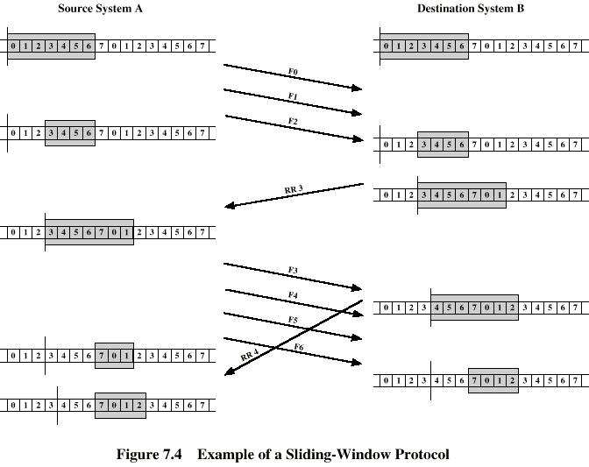
Example Sliding Window

Slide 9
Error Detection
Additional bits added by transmitter for error detection code
Parity
Value of parity bit is such that character has even (even parity) or odd (odd parity) number of ones
Even number of bit errors goes undetected

Slide 10
Cyclic Redundancy Check
For a block of k bits transmitter generates n bit sequence
Transmit k+n bits which is exactly divisible by some number
Receive divides frame by that number
If no remainder, assume no error
For math, see Stallings chapter 7

Slide 11
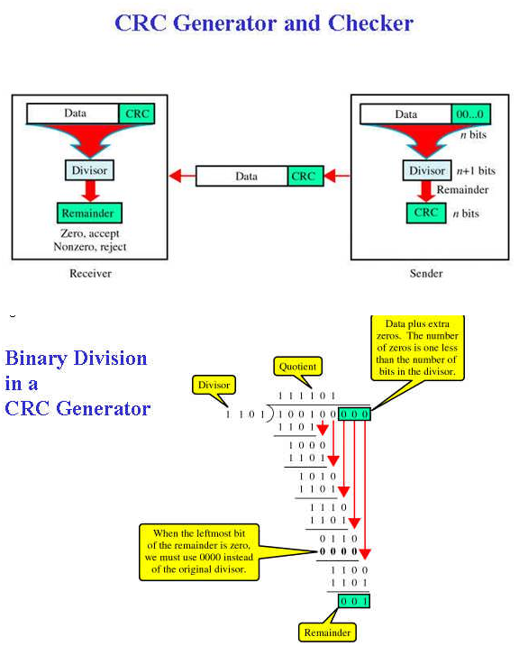
Cyclic Redundancy Check
For a block of k bits transmitter generates n bit sequence
Transmit k+n bits which is exactly divisible by some number

Slide 12
Error Control
Detection and correction of errors
Lost frames
Damaged frames
Automatic repeat request
Error detection
Positive acknowledgment
Retransmission after timeout
Negative acknowledgement and retransmission

Slide 13
Automatic Repeat Request (ARQ)
Stop and wait
Go back N
Selective reject (selective retransmission)

Slide 14
Stop and Wait
Source transmits single frame
Wait for ACK
If received frame damaged, discard it
Transmitter has timeout
If no ACK within timeout, retransmit
If ACK damaged,transmitter will not recognize it
Transmitter will retransmit
Receive gets two copies of frame
Use ACK0 and ACK1

Slide 15
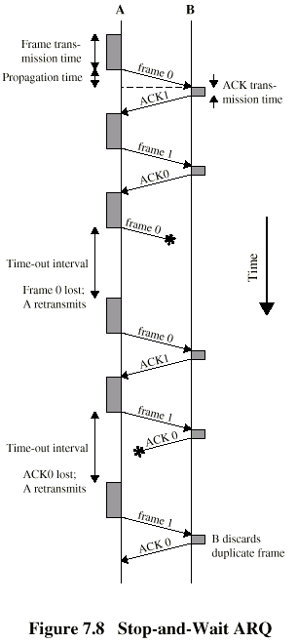
Stop and Wait - Pros and Cons
Simple
Inefficient

Slide 16
Go Back N (1)
Based on sliding window
If no error, ACK as usual with next frame expected
Use window to control number of outstanding frames
If error, reply with rejection
Discard that frame and all future frames until error frame received correctly
Transmitter must go back and retransmit that frame and all subsequent frames

Slide 17
Go Back N - Damaged Frame
Receiver detects error in frame i
Receiver sends rejection-i
Transmitter gets rejection-i
Transmitter retransmits frame i and all subsequent

Slide 18
Go Back N - Lost Frame (1)
Frame i lost
Transmitter sends i+1
Receiver gets frame i+1 out of sequence
Receiver send reject i
Transmitter goes back to frame i and retransmits

Slide 19
Go Back N - Lost Frame (2)
Frame i lost and no additional frame sent
Receiver gets nothing and returns neither acknowledgement nor rejection
Transmitter times out and sends acknowledgement frame with P bit set to 1
Receiver interprets this as command which it acknowledges with the number of the next frame it expects (frame i )
Transmitter then retransmits frame i

Slide 20
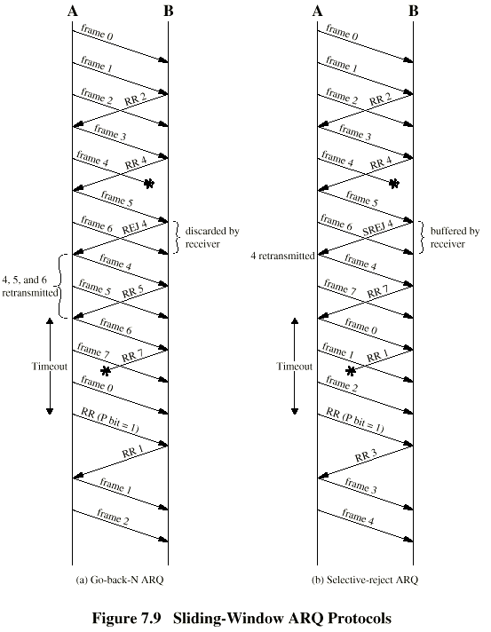
Go Back N - Diagram

Slide 21
Selective Reject
Also called selective retransmission
Only rejected frames are retransmitted
Subsequent frames are accepted by the receiver and buffered
Minimizes retransmission
Receiver must maintain large enough buffer
More complex mechanism in transmitter

Slide 22
Selective Reject - Diagram

